Slide 1



Global Alliance for Public Relations
& Communications Management
in associating with
School of Communications and Reputation (SCoRE)
presents
GLOBAL COMMUNICATIONS WEEK
Student and Young Practitioners Month
The Wole Adamolekun Story – A toast to
public relations and communication
November 30, 2024

Slide 2
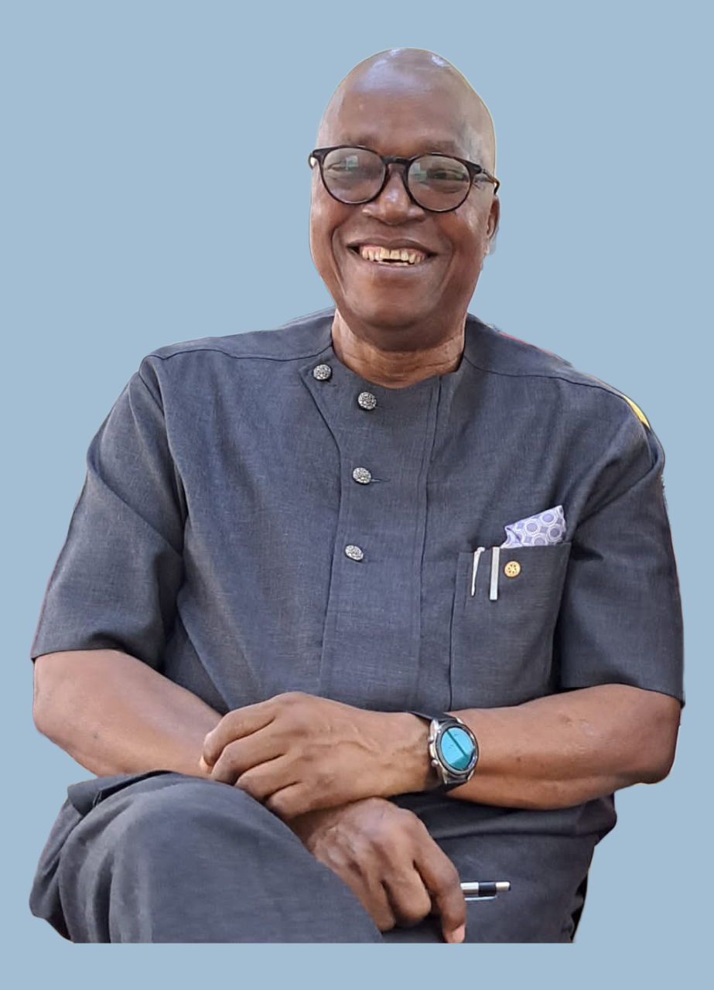
Wole Adamolekun, PhD
Wole Adamolekun is an Associate Professor of Mass Communication, Elizade University, Ilara-Mokin, Ondo State, Nigeria. He has over four decades experience in corporate communications in downstream oil and gas sector; micro credit administration, youth, and social development culminating his career as Chief Executive Officer. He is the author of three public relations books, co-authored 10 chapters in books and published several scholarly articles in reputable journals in Nigeria and internationally. He is a Fellow of the Nigerian Institute of Public Relations; Fellow, Nigerian Institute of management; Fellow, African Public Relations Association and ex-Secretary-General. He is a member of the International Public Relations Association; Chartered Institute of Public Relations, United Kingdom; Public Relations Society of America; and Board Member, Commission for Public Relations Education, USA, and Global Alliance for Public Relations and Communication Management. At Elizade University, he is presently the interim Head of Department of Mass Communication and interim Director of Academic Planning.

Slide 3
In the beginning……
Early in life I set out to achieve excellence and as I grew up I desired to be:
Writer
Banker
Agriculturist and at a point, (Agricultural Communication)
Hydrocarbon industry and
The Academia
All these and more I achieved with distinction and in very good timing. Interestingly, all the high profile jobs I got were by recommendation as a result of my communication and research skills – What can I offer you to make you work for me?
Notes:
Field Assistant in Geological Research

Slide 4
Professional and academic pursuits have been in communication (English/Journalism/Communication Art/Media Arts). Work experiences:
Youth & Social Development
Basic Research - information gathering, processing, dissemination and technology
Grassroots development communication
Rural Banking
Oil and Gas.
Means - strategic communication, cultivated contacts in Government, the academia, media, private sector and the professions
Public relations is a profession of possibilities and this has been amply demonstrated in my work experiences.

Slide 5
Encounter/Career I: Freelance Journalist (Campus Journalism)
Education - Continuous
Training – Mentorship (learn from the masters)
Reading and learning
Editor
Reporter
Columnist
Interviewer
Reviewer (books, cinema, recitation, drama…)
Write, research multiple areas
To succeed, de-emphasise pecuniary gains (work for free; voluntarism), organised, be toughness and adapt
Literary Mentors: Professor Ladipo Adamolekun, Professor Kole Omotoso, Mr. Olofin, Tola Adenle

Slide 6
Encounter/Career II: National Youth Service Corps
Corps Public Relations Officer – What is that?
Demanded to be part of the inspectorate
Added research Skills and initiated research studies (10th Anniversary)
Accepted responsibility beyond communication (Secretary to Committees etc..)
Furthered education through masters degree
Editing and publishing roles
Initiated the first in-house research (later became a full fledged division)
NYSC Agricultural & Community Development Service (All-Year Round) communications

Slide 7
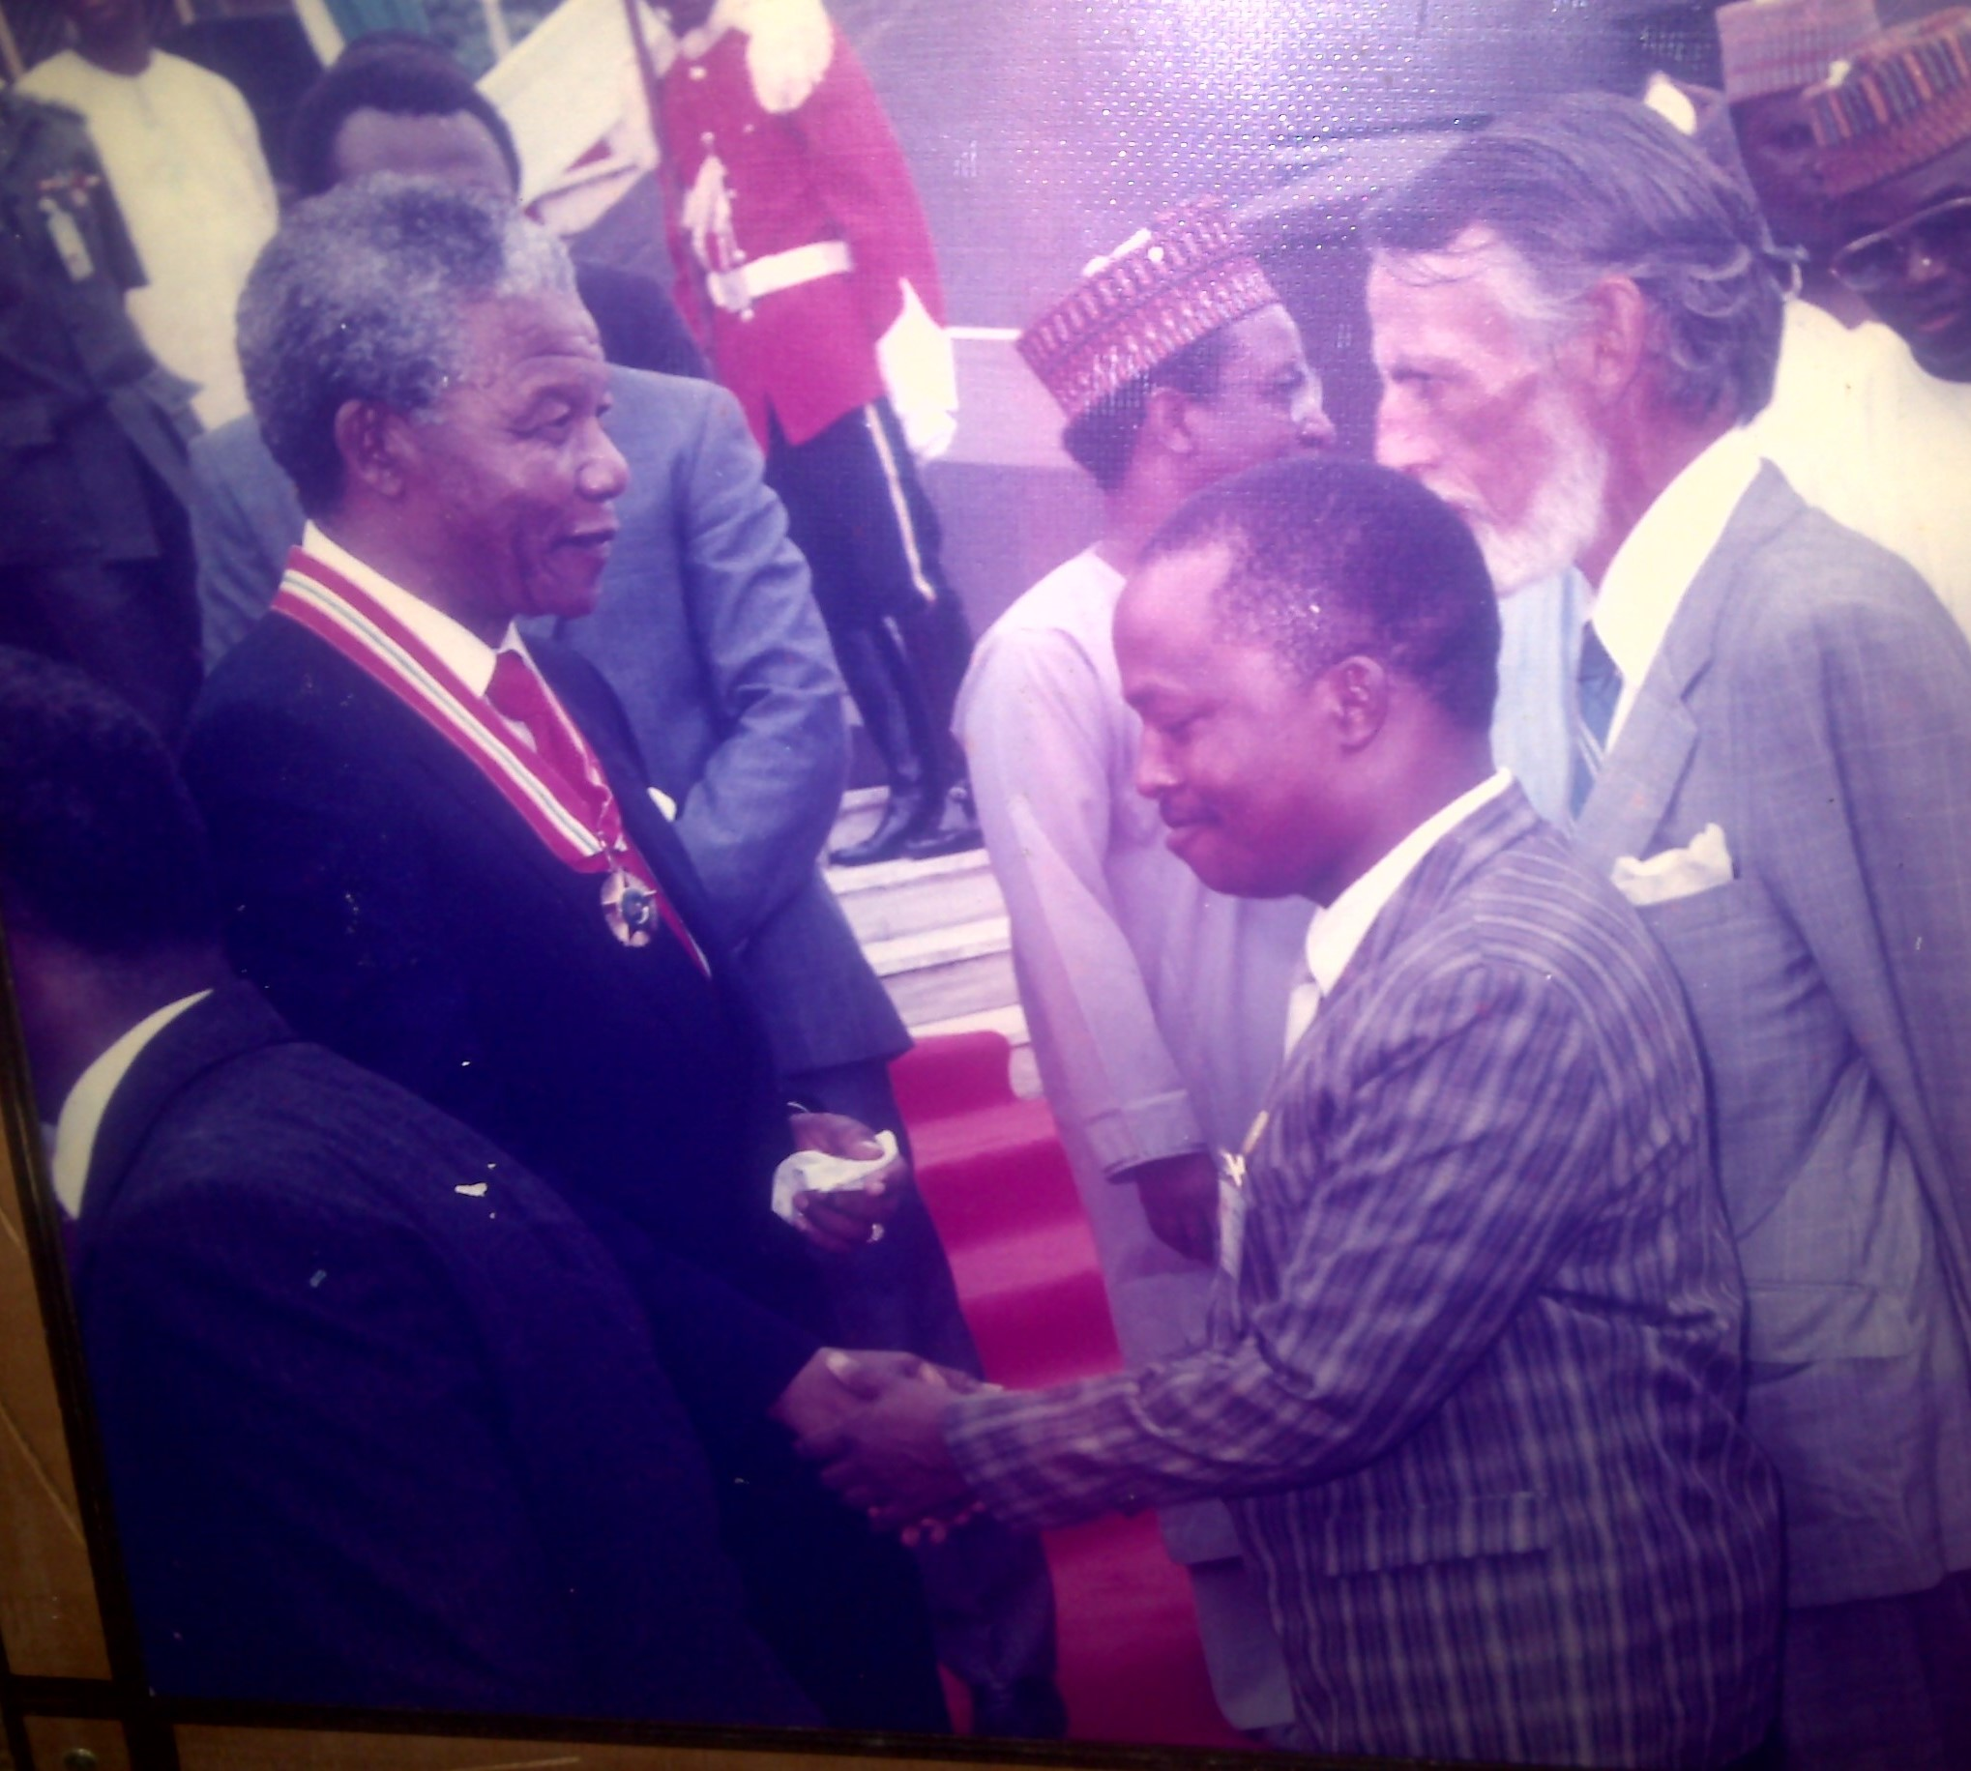
Encounter/Career III: Social Mobilisation/Political Communication
Grassroots Political Education
Nationwide Social Mobilisation (72-day musical road shows)
Stakeholder Engagement
Media and international liaison
How can you mobilise a hungry man?
President Nelson Mandela’s visit to Nigeria in 1990

Slide 8
Encounter/Career IV: Rural Financial Intermediation
How can you mobilise a hungry man?
Assigned the role of coordinating research on rural banking
Appointed on the Implementation Committee for Community Banking
Assumed the role of researcher and strategist
How can you mobilise a hungry man?
Research on Rural Banking (Bangladesh Gramean Bank, Ghana Rural Bank….)
Peoples’ Bank
Community Bank (Modernising the Informal Financial Intermediaries….)
Third-tier Banking Sector – Micro Finance Banks (1008)
What can I offer you that will make you work for me?
Accelerated Promotions

Slide 9
Encounter/Career V: Oil & Gas
Communication skills, research capability aided my being head hunted for the Downstream Petroleum Sector Liberalisation and Deregulation…..
Anchored the Secretariat of the Restructuring and Implementation Committees
Pioneer General Manager (Corporate Services)
Interim Executive Secretary/CEO
General Manager Operations & General Manager Corporate Services
Managed the extensive, emotive and sensitive national challenge – subsidy removal
Managed Labour & Stakeholders challenging relationships (strikes, negotiations, strikes….)
Public Service mentors – Soji Oni, Professor Tunde Adeniran, Professor Akin L. Mabogunje, Babaijo O O O Ogunkua

Slide 10
Encounter/Career VI: Academics (Post Public Service & Retirement)
Specialisation Areas: Strategic Communication, Corporate Social Responsibility, Tourism
Communication, Crisis Communication and Applied Communications
Teaching:
Extensive teaching in wide ranging public relations and communication subjects
Research:
Delivered first international conference paper in 1989 I Burkina Faso
Authored 4 Public Relations Books
Co-Authored 14 Book Chapters on Public relations and Communications
Published over 38 scholarly articles in peer reviewed journals worldwide
Community Service:
Head of Department
Dean, Student Affairs
Director, Academic Planning
Member, Board of School of Postgraduate Studies
Chairman, Sports Committee
Academic Mentors – Batilloi Warritay, Professor Cornelius B. Pratt, Professor Amiso George….

Slide 11
Putting your best foot forward via CVs & Profiles
Prepare bespoke profile(s)
Curriculum Vitae to reflect the totality of your experiences and skills (update regularly and take steps to improve your skills)
United Nations Development Programme, 1985 (triggered my interest in getting a doctorate degree)
The World Bank (1996) (unsolicited invitation)

Slide 12
Professional Affiliations
No man can achieve professionalism on his own, he needs the institute – John Crinsford
Nigerian Institute of Public Relations, Fellow
Nigerian Institute of Management, Fellow
Ex- Secretary General, African Public Relations Association (APRA)
Board Member & Chair, Academic and Research Council, Global Alliance for Public Relations and Communication Management,
Senior Member, International Public Relations Association (IPRA)
Fellow and Ranking Council Member, African Public Relations Association,
Member, Public Relations Society of America (PRSA),
Member, Chartered Institute of Public Relations, United Kingdom (CIPR).

Slide 13
Ethics Matter
As public relations practitioners, ethics should be prioritised in all that we do.
Of 4 top management, I was the only 1 retained and appointed as interim Executive Secretary.
At another time, we were 5 General Managers, 4 were redeployed. For 2 years, I was the only General Manager combining 2 positions (Operations and Corporate Services) until I retired from public service.

Slide 14
Challenges
excellent public relations needs the media less than does poor public relations and as organisations
depend less on the media, the better their relationship with the media will become. J. Grunig
Media relations
Intellectualising public relations practice
Funding
Underestimated, undervalued & miniaturised
Hybrid work place
Technology
Non-professionals

Slide 15
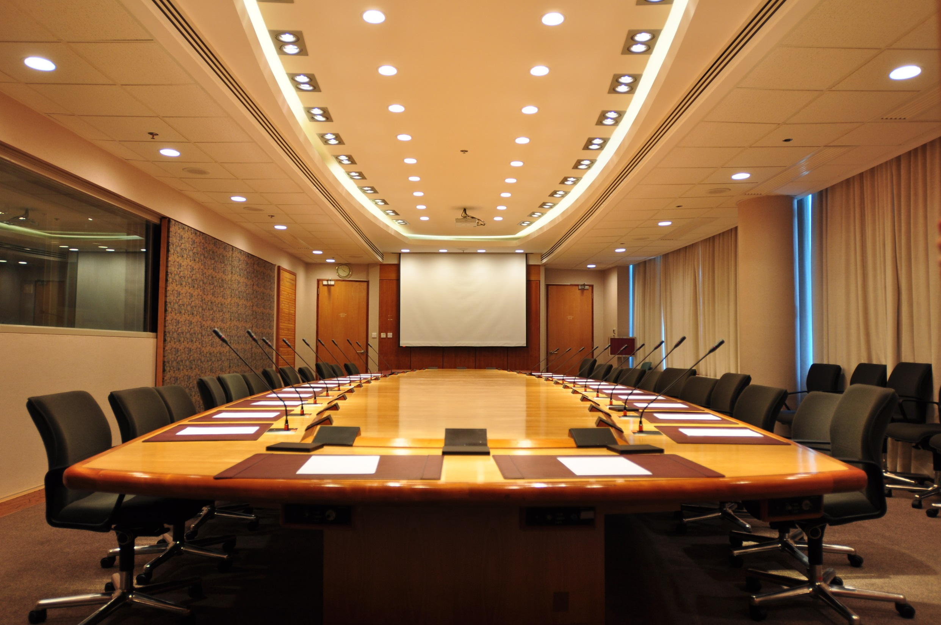
Success Factors….
Destination….
Board Room!!
Ideas rule the world
Reputation Matters
Networking
Seek and acquire knowledge
Be a problem solver
Ethical
Technology savvy
Critical & strategic thinking
Research
Data Analytics
Financial literacy
Be in the know
Self Branding
Listening
Humility
Impact Society
BEING in the KNOW
COMMUNICATE

Slide 16
AWARDS & RECOGNITIONS
Nigerian Institute of Public Relations Life Time Achievement Award, 2024
National Universities Commission Hall of Fame, Core Curriculum Minimum Academic Standard (CCMAS), 2023
Distinguished Treasured Leadership Award, Nigerian Institute of Public Relations, Ondo State Chapter, 2023
Excellence Award, Petroleum and Natural Gas Senior Staff Association of Nigeria, PPPRA Branch, Abuja. (2016)
Recognition and Performance Award, Nigerian Institute of Public Relations, Abuja, 2015
Distinguished PR Practitioner, Nigerian Institute of Public Relations, Abuja Chapter, 2012
Outstanding Public Relations Practice Award, MediaGate Leadership Development Project (2004)
Best Public Relations Practitioner Award. Nigerian Institute of Public Relations, Abuja Chapter (1995)
Young Manager of the Year Award by the Nigerian Institute of Management, (1992)
Federal Government Scholar, University of Ibadan, Master of Communication Arts, (1983).

Slide 17
THE END
I thank you for your attention
Questions???
Wole.adamolekun@lizadeuniversity.edu.ng
lolese123@gmail.com
https//woleadamolekun.com.ng

